Slide 1
OSS BSS NMS: Bird’s Eye View
- Prakash Kajave

Slide 2
Objectives
At the end of this session, you will be able to:
  Understand end to end service fulfillment life cycle at abstract level
  List telecom business issues
  Explain the high level composition of telecom system stack
  Differentiate between north bound system and south bound system
  Differentiate between customer facing system and network facing system
  List key areas under BSS, OSS and NMS
  Understand the purpose of such classification
CONFIDENTIAL© Copyright 2007 Tech Mahindra Limited

Slide 3
Agenda
Service fulfillment – End to End life cycle
Telecom business issues
Telecom business solution – TELCO stack
Key areas / systems in BSS, OSS and NMS space
CONFIDENTIAL© Copyright 2007 Tech Mahindra Limited

Slide 4
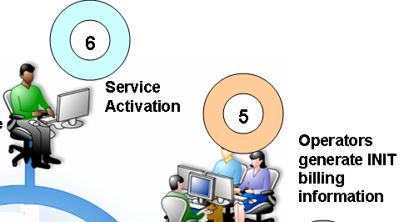
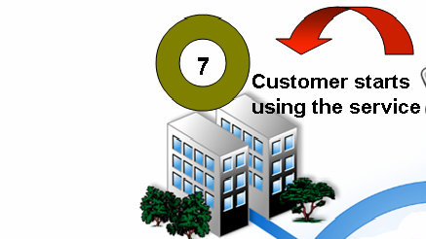

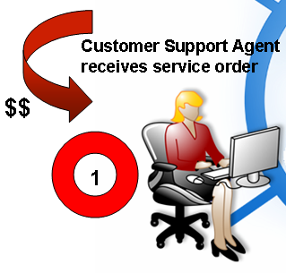
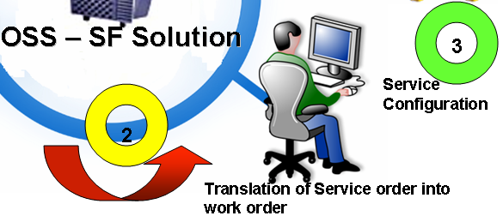
Service Fulfillment Cycle
CONFIDENTIAL© Copyright 2007 Tech Mahindra Limited

Slide 5

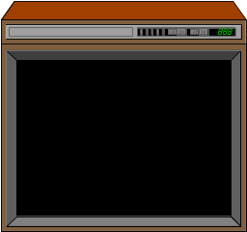


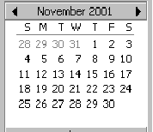
Using a Service
Customer’s Starts using a service
BROADBAND
NETWORK
BROADBAND
NETWORK
BROADBAND
NETWORK
BROADBAND
NETWORK
BROADBAND
NETWORK
NOV 08
Monthly Bill
Cycle
Customer Chooses a Bill Cycle : Bill date as 21st of Month and Bill Frequency : 1 Month
CONFIDENTIAL© Copyright 2007 Tech Mahindra Limited
Notes:
System in Scope: Mediation , Rating and Discounting

Slide 6
Invoice for a Service
Customer’s gets an invoice / bill at the end of bill cycle
Generic Telecommunications Ltd
The Old Granary
Oakington Road
Westwick
Mr A N Other,
Cambridge
123 Nowhere Road,
CB4 5AR
Nowhere.
AA1 1AA
INVOICE
Account Number: 1234-5678-9
Basic
Discount
You pay
Phone + TV Package
Line Rental
4.50
10%
4.05
Voice Mail
1.00
10%
0.90
Friends and Family
2.50
2.50
CATV Subscription
12.50
10%
11.25
Movie Subscription
15.00
10%
13.50
Internet +
Pay per View
4.99
0.00
EMail address
10.00
0.00
Web space (5MB)
5.00
10%
4.50
Total ex VAT
36.70
VAT @ 17.5%
6.42
bank giro credit
Total inc VAT
43.12
Bank
Royal Bank of Scotland
Total Cash
Account
Generic Tech. Ltd. 12345678
Cheques
Pain in by
PO's etc
24-67-12
Ref No.
549832 HFS 12
£
5000 234 23 41 32 4 1234 2 3 5667 5
<24355462456< 266577+ 1002534523< 76 X
DEC 08
Monthly Bill
Cycle
Invoice Date : 21st Dec 08
Invoice Amount : Rs. 1435/-
Payment Due Date : 31th Dec 08
CONFIDENTIAL© Copyright 2007 Tech Mahindra Limited
Notes:
System in Scope: Billing, Discounting, Taxation, Bill Formatting

Slide 7

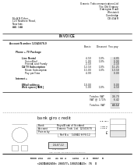



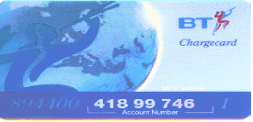
Payment for a Service
Customer’s Pays a bill by a payment method captured during Order
Cash
Dec 08
Other Payment Method Options
Direct Debit
88-99-75
Cheque
Dodgy Bank plc.
End of Road
Sometown
£
p
Credit Card
Pay or order
8 8 - 9 9 - 7 5 1 6 7 5 9 8 3 7 J Bloggs
CONFIDENTIAL© Copyright 2007 Tech Mahindra Limited
Notes:
System in Scope: Account Receivables, General Ledger , Dunning / Collection

Slide 8
Telecom Business: Issues !!!
How to capture an order? How to validate it? What are the different channels through which an order can be taken?
Do we have enough network capacity to fulfill an order?
Do we have enough set top boxes to fulfill an order?
Whether service is available in an area where customer is asking for?
Who is available to install IPTV and Configure set top box now? How to inform that specific field engineer?
How to make sure that order is completed in time so that customer is happy?
What if customer changes a mind set and changes a plan or place of installation? How to take care of this?
What is the status of an order at any point in time?
CONFIDENTIAL© Copyright 2007 Tech Mahindra Limited

Slide 9
Telecom Business: Issues!!!
What are different plans available for sale?
  How to configure them? Is there any type of discount?
How to rate usage of IPTV service? How to bill IPTV service? How to tax?
What are the different channels of accepting a payment? What if customer does not make a payment in time? Should we penalize or disconnect a service? How long to wait?
What if customer asks to suspend the service for certain duration because exams are on the way!!! How to take care of that? How to capture such requests ?
Customer complains about bad reception / no reception. How to capture complaints? How to resolve the complaints? Who can repair a fault? What is the time required to repair a fault? Is there any problem in set top box or network itself?
Customer wants to see his usage at any point in time. How to make that information available?
CONFIDENTIAL© Copyright 2007 Tech Mahindra Limited

Slide 10


Telecom Business: Solution!!!
Customer Facing Systems
Needs a streamline Quality Business Processes and Collection of suite of systems/products to solve this!!!
Network Facing Systems
Network
CONFIDENTIAL© Copyright 2007 Tech Mahindra Limited

Slide 11
TELCOM Umbrella: BSS
Business Support Systems facilitate the relationship of service provider with their customers.
BSS can be thought of as “Customer-facing Systems” or ‘North Bound Systems’
BSS
OSS
Network Facing Systems
NMS
Network
CONFIDENTIAL© Copyright 2007 Tech Mahindra Limited

Slide 12
TELCOM Umbrella: OSS
Operations Support Systems facilitate the operations of the communications carrier’s network.
OSS can be thought of as ‘Network-facing Systems’ or
‘South Bound Systems’.
BSS
OSS
NMS
Network
CONFIDENTIAL© Copyright 2007 Tech Mahindra Limited

Slide 13
TELCOM Stack: BSS Key Areas
BSS
BSS Key Areas:
CRM [Customer Relationship Management]
  Order Management ( entry and query)
  Sales Workforce Management
  Campaign Management
Rating & Billing
Account Receivables and Payment
Revenue Assurance and Fraud Management
Mediation
OSS
NMS
CONFIDENTIAL© Copyright 2007 Tech Mahindra Limited

Slide 14
TELCOM Stack: OSS Key Areas
OSS Key Areas:
Order Management
  Service Fulfillment : Provisioning and activation
Inventory Management
  Physical Inventory
    Network Inventory
    Service Inventory
  Logical Inventory
    Number Inventory
Trouble Ticket Management
  Network Trouble Ticket
  Customer Trouble Ticket
BSS
OSS
NMS
CONFIDENTIAL© Copyright 2007 Tech Mahindra Limited

Slide 15
TELCOM Stack: NMS Key Areas
BSS
OSS
NMS Key Areas:
Performance Management
SLA Management
Fault Management
Network Design & Planning
NMS
CONFIDENTIAL© Copyright 2007 Tech Mahindra Limited

Slide 16
TELCO Stack / Telecom Umbrella
CRM, Rating, Billing, Payments, Mediation
Debt Management, Revenue Assurance,
Fraud Management, Settlements,
Business Intelligence, Portal,
BSS
Order Management, Provisioning,
Activation, Inventory Management
Trouble Ticket management
OSS
Fault Mgmt, Performance Mgmt,
SLA Mgmt, Element Management
Network planning, Design
NMS
CONFIDENTIAL© Copyright 2007 Tech Mahindra Limited
Notes:
Business Support Systems facilitate the relationship of service provider with their customers. BSS can be thought of as “Customer-facing Systems”.
BSS Systems have ‘North Bound Interfaces’ to the customers. e.g. CRM, Billing, etc.
BSS Systems Key areas
CRM [ Customer Relationship Management]
Order Management
Sales Workforce Management
Campaign Management
Rating & Billing
Retail v/s Wholesale
Roaming v/s Interconnect
Mediation
Account Receivables and General Ledger
Revenue Assurance
Fraud Management
GSM (Global System for Mobile communications) is an open, digital cellular technology used for transmitting mobile voice and data services.
GPRS (General Packet Radio Service) is a very widely deployed wireless data service, available now with most GSM networks.
3G/WCDMA (Third Generation / Wideband Code Division Multiple Access) enables the continued support of voice, text and MMS services in addition to richer mobile multimedia services such as Music, TV and video, Entertainment content , Internet access
4G technology - HSPA - High speed packet access
Standardised by 3GPP, HSPA is the set of technologies that defines the migration path for 3G/WCDMA operators worldwide. HSPA, which uses the FDD transmission scheme, includes HSDPA (High Speed Downlink Packet Access), HSUPA (High Speed Uplink Packet Access) and HSPA Evolved.

Slide 17
Summary
In this session, we discussed about:
  End to end service life cycle including billing and payment
  Telecom business issues and high level solution to it
  Definition of BSS, OSS and NMS
  Different key areas under BSS, OSS and NMS
CONFIDENTIAL© Copyright 2007 Tech Mahindra Limited

Slide 18
Glossary
TELCO : Telecom Company
OSS : Operations Support System
BSS : Business Support System
NMS : Network Management System
CRM : Customer Relationship Management
SLA : Service Level Agreement
SF : Service Fulfillment
IPTV : Internet Protocol Tele Vision
CONFIDENTIAL© Copyright 2007 Tech Mahindra Limited

Slide 19



Any Queries…
&
Questions
Answers
CONFIDENTIAL© Copyright 2007 Tech Mahindra Limited

